Slide 1
Predicting Customer Churn at Telco Communications
Matthew Davis
Stephen Hartigan
Sridhar Rangan
MIST.6060, Fall 2018

Slide 2

Our Dataset
Data set from Kaggle
Anonymized sample IBM set named "Telco Communications"

Slide 3
What is Customer Churn?
Important aspect of any B2B or B2C business
Indicates whether a customer will halt doing business

Slide 4
Why Customer Churn Matters
Acquiring customers more expensive than retaining existing ones
Oracle study indicates need to focus on customer service

Slide 5

Technique
Our Cleansing Process

Slide 6
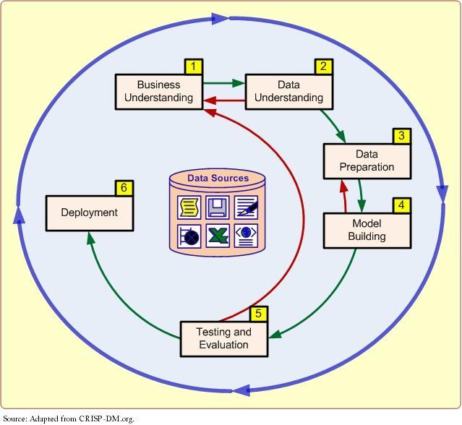
CRISP-DM
Cross-Industry Standard Process for Data Mining

Slide 7
Data Description
Observations: 7043
Variables: 22
11 Missing Values in the Dataset
Removed all 11 observations.
Removed customerID
3 additional columns added:
“TotalDiff”
“tenure1”
“MonthlyCharges1”
Resulting dataset: 7,032 observations, 19 variables and one class attribute.

Slide 8
Data Description
Name of Attribute | Data Type | Description
Gender | Categorical | Male, Female
Senior Citizen | Numeric | 0 = No, 1 = Yes
OnlineSecurity | Categorical | Whether customer has online security or not
OnlineBackup | Categorical | Whether customer has online backup or not
… | … | …
Notes:
6 numeric, 16 categorical variables

Slide 9
Data Description
Renaming For Simplicity in Models
MultipleLines: “No”, “Nps”, “Yes” | InternetService: “DSL”, “FO”, “No”
OnlineSecurity: “No”, “Nis”, “Yes” | OnlineBackup: “No”, “Nis”, “Yes”
DeviceProtection: “No”, “Nis”,“Yes” | TechSupport: “No”, “Nis”, “Yes”
StreamingTV: “No”, “Nis”, “Yes” | StreamingMovies: “No”, “Nis”, “Yes”
Contract: “M-T-M”, “1yr”, “2yr” | PaymentMethod: “BT”, “CC”, “EC”, “MC”

Slide 10

Descriptive Statistics

Slide 11
Descriptive Statistics
Notes:
Half male, half female, 76% no churn, 24% churn

Slide 12
Descriptive Statistics

Slide 13
Dataset

Slide 14
Dataset

Slide 15
Dataset

Slide 16
Dataset

Slide 17
Model Evaluation
J48 – Decision Trees
Naïve Bayes
Support Vector Machine (SMO)

Slide 18
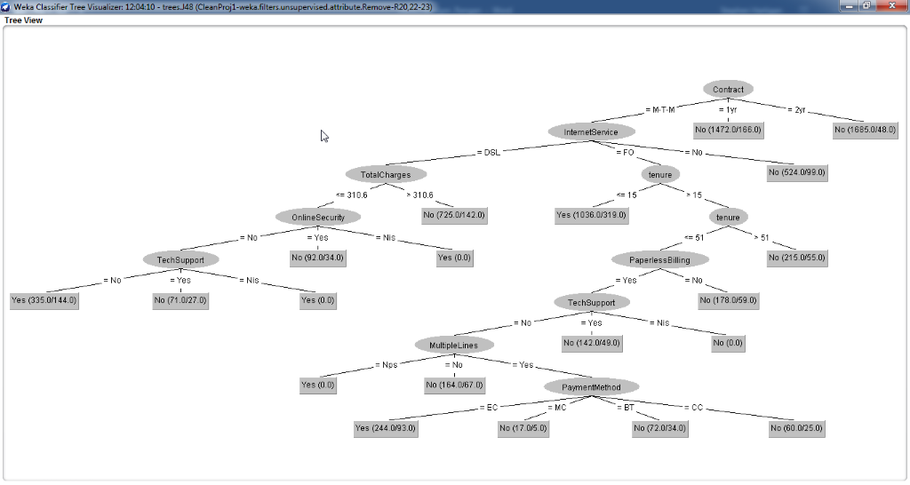
J48 – Decision Trees

Slide 19
J48 – Decision Trees
Top Predictors:
“Contract”
“InternetService” (FO)
“TotalCharges”
“tenure”

Slide 20
Model Comparison
Decision Tree (J48)
 | No | Yes
No | 4575 | 588
Yes | 892 | 977
Naive Bayes
 | No | Yes
No | 3608 | 1555
Yes | 370 | 1499
Support Vector Machine
 | No | Yes
No | 4612 | 551
Yes | 866 | 1003

Slide 21
Model Comparison
Metrics | J48-Min (70) | Naïve Bayes | SMO
Accuracy | .7895 | .7263 | .7985
TP Rate | .8861 | .6988 | .8933
TN Rate | .5227 | .8020 | .5367
Pos. Pred. Value | .8368 | .9070 | 8419
Neg. Pred. Value | .6243 | .4908 | .6454
ROC Area | .8180 | .8190 | .7150
Notes:
Discussion on the comparison of ROC (Reciever Operating Characteristic)
Found by plotting the “True Positive Rate” (a.k.a. “Sensitivity”) to the “False Positive Rate”.

Slide 22

Large image
Implications & Recommendations

Slide 23
Recommendations
Market to DSL Customers and emphasize adding services
Focus on customer engagement

Slide 24


Questions?

